Slide 1


Medical Assistive Web Robot
C-13
22MAT230 MATHEMATICS FOR COMPUTING - 4
22AIE214 INTRODUCTION TO AI ROBOTICS
Name | Roll No
K S Venkatram | CB.SC.U4AIE23236
Sanggit Saaran K C S | CB.SC.U4AIE23247
Vishal Seshadri B | CB.SC.U4AIE23260
Surya HA | CB.SC.U4AIE23267

Slide 2
INTRODUCTION
In modern hospital settings, repetitive tasks such as delivering medications and monitoring patients can burden healthcare staff, leading to inefficiencies and errors.
This project focuses on developing an autonomous robot equipped with LiDAR-based SLAM for navigation and a web interface for intuitive control.
Initial robotic ideas faced hardware limitations, but the availability of the JetHexa robot gave us a real opportunity to build something functional.
The robot uses laser-based sensing and onboard odometry for mapping and localization, which is visualized using RViz.
Future Expansion
The system is designed to eventually integrate with hospital IT systems (like HIS/EHR), support medication delivery tasks, and automate scheduling and logging — although these features are not yet fully implemented.

Slide 3
LITERATURE REVIEW
No | Title | Journal and Year | Authors | Key Outcomes | Limitations
1 | Development of a Service Robot for Hospital Environments in Rehabilitation Medicine with LiDAR-Based SLAM | arXiv 2024 | Sayat Ibrayev, Arman Ibrayeva, et al. | Developed a medical service robot using 3D LiDAR and SLAM for hospital navigation. Integrated NDT Matching for mapping and obstacle avoidance. Validated via manual maneuvers and ROS simulations. | - High computational demand for real-time processing. - Needs further testing in dynamic hospital settings.
2 | Agile mobile robotic platform for contactless vital signs monitoring | Symmetry 2023 | Hen-Wei Huang , peter chai , et al | Developed an AI-powered mobile robot for autonomous navigation and biometric data collection. Integrated face detection and distance estimation with InsightFace. Applied a compensation algorithm for accurate thermal imaging. | Limited by ambient temperature variations, impacting IR accuracy. Motion artifacts affect rPPG-based HR and SpO2 measurements.

Slide 4
LITERATURE REVIEW
No | Title | Journal and Year | Authors | Key Outcomes | Limitations
3 | Development of LIDAR-SLAM Integrated Low Cost Health Care Monitoring Robot with Sustainable Material | 9th International Conference on Control and Robotics Engineering (ICCRE), 10-12 May 2024 | Amruta Rout, Hemanth Reddy, Sri Vardhan Raj, et al. | The robot integrates LIDAR-SLAM for autonomous navigation, uses sustainable materials like bamboo, and performs tasks like medicine delivery, monitoring, and sanitization. | Potential durability concerns with bamboo-based robotic components. Requires further AI integration for improved healthcare services and decision-making
4 | Mobile Robotic Platform for Contactless Vital Sign Monitoring | Cyborg and Bionic Systems, Vol 2022, 30 Apr 2022 | Hen-Wei Huang, Jack Chen, Peter R. Chai, Claas Ehmke, et al. | Dr. Spot, a teleoperated quadruped robot, enables accurate, contactless monitoring of vital signs while maintaining social distancing in hospital settings. | The system relies on external control rather than full autonomy. long-term usability remain untested
4

Slide 5
LITERATURE REVIEW
No | Title | Journal and Year | Authors | Key Outcomes | Limitations
5 | CMS-Robot: A Cloud Medical Service Robot Merging SLAM and IoT for Enhanced Healthcare Delivery | IEEE 19th Conference on Industrial Electronics and Applications (ICIEA) 2024 | Yubin Huang, Yihao Wang, Xiaofeng Li, et al. | The robot enhances hospital efficiency by integrating SLAM and IoT for autonomous navigation, remote monitoring, and patient care. | Navigation accuracy may be affected in highly dynamic environments, and obstacle avoidance in crowded spaces remains a challenge.
6 | Home-care nursing controlled mobile robot with vital signal monitoring | Bionic Systems November 2022 | Caridad Mireles, Misael Sanchez, David Cruz-Ortiz, et al. | The robot effectively monitors vital signs and assists in the gait cycle for home-care patients using 3D-printed components and embedded sensors. | Limited testing with only 5 volunteers; scalability and long-term performance in real-world home settings remain unverified.

Slide 6
OBJECTIVE
Autonomous Navigation: Implement a real-time LiDAR-based SLAM system using RTAB-Map for accurate indoor mapping and autonomous path planning.
Precision & Obstacle Avoidance: Enable the robot to safely navigate through hospital-like environments using LiDAR and onboard sensors.
Remote Control Interface: Develop a web-based interface to send navigation commands and monitor the robot’s location and task status in real time.
Flexible Control Architecture: Design a system where perception and navigation are separated, allowing for better reliability and adaptability in real-time conditions.
Foundational Platform for Future Integration: Build a system for secure processing and storage of medical data, enabling smooth integration of patient vitals and task updates.

Slide 7
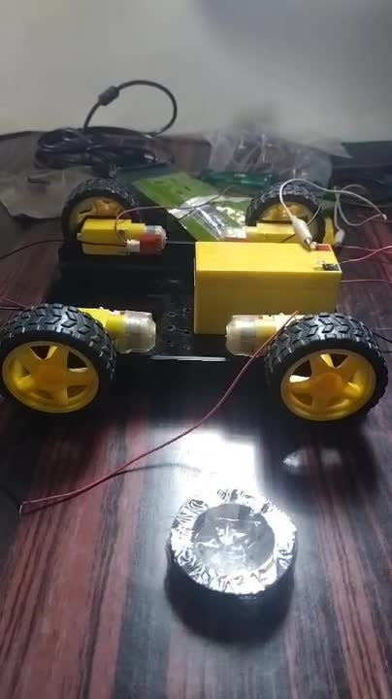
INITIAL ATTEMPTS
Initially Started with our own Wheeled-Robot kit connected to four DC motors with 12v Battery and Raspberry Pi 3B.
Problem Faced
Failure of Raspberry Pi 3B due to the inability to run GUI, leading to an upgrade to Raspberry Pi 4B
Raspberry Pi 4B ran the GUI but faced limitations such as high computational demands for RTAB-Map.
Inadequate motor power and lack of odometry data caused navigation unreliable and the absence of LiDAR made SLAM implementation infeasible.
Solutions
Restarted the Project with a LiDAR-integrated Jetson Nano-based robot, chosen for its GPU support, which ensured better navigation and helped us handle SLAM processing efficiently.

Slide 8
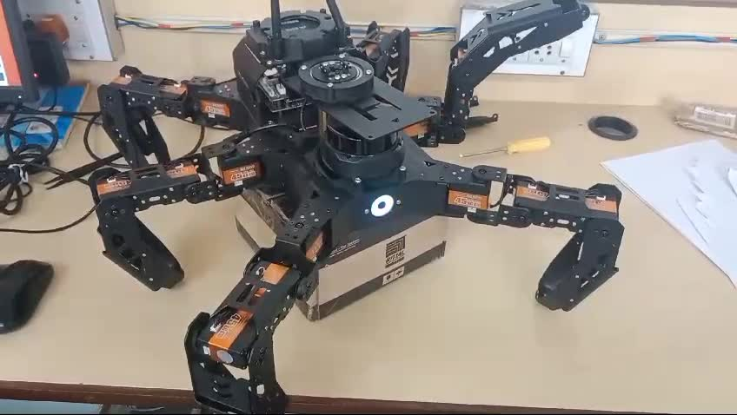
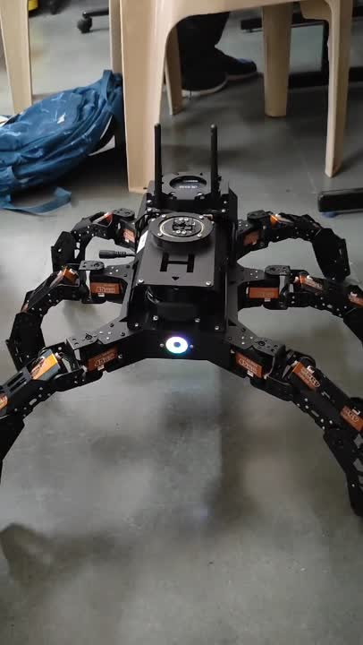
METHODOLOGY
Hiwonder Hexapod
Transitioned to using the JetHexa hexapod robot with Jetson Nano(4GB) to overcome computational limitations.
Equipped with RPLiDAR and internal IMU for environment scanning and navigation.
Pre-installed with ROS1 Melodic and supported packages for control and SLAM.
Implemented RTAB-Map for SLAM to enable real-time mapping and localization.
Used RViz for live visualization and map interaction during SLAM testing
Conducted controlled environment trials to validate performance

Slide 9
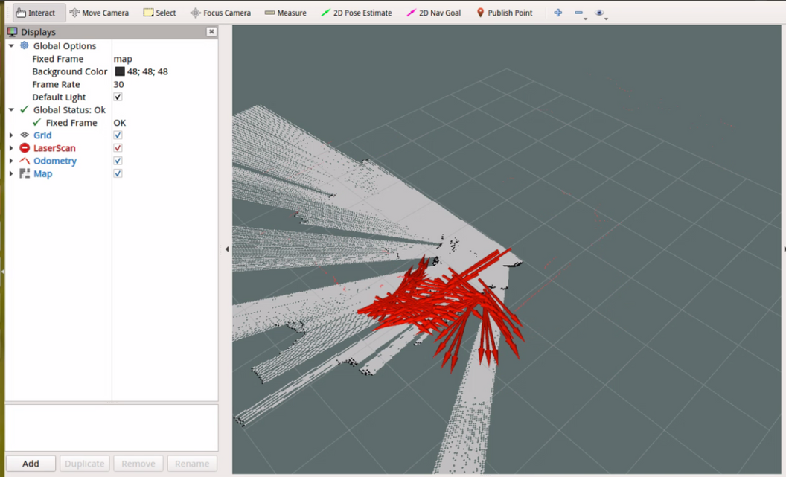
METHODOLOGY
Laser Scan Visualization – RPLiDAR emits 360° laser beams, visualized as a 2D scan in RViz to show surrounding obstacles.
Obstacle Detection – Detected objects are represented as point clouds or lines on the map.
Robot Pose & Orientation – The robot’s position (x, y) and heading (θ) are visualized using TF arrows and coordinate frames.
Odometry Tracking – Leg kinematic data and IMU readings are fused for pose estimation and visualized through the /odom Topic.
SLAM Mapping Process – RTAB-Map builds a real-time map using LiDAR + Odometry data, publishing to /map.
MAP using RPLiDAR
Loop Closure Detection – When the robot revisits known areas, SLAM refines the map by correcting accumulated drift, ensuring consistent mapping.

Slide 10
SYSTEM ARCHITECTURE
The system is split into two main parts: Sensing + Perception and Control + Navigation.
Navigation decisions are based on the generated map, with obstacle avoidance using LiDAR.
The web control UI is designed using Flask, HTML, and JavaScript, and is hosted on a local network.
Intended features of the UI include map display, navigation buttons, and live robot status updates.
Web interface would provide an intuitive GUI alternative to RViz for non-technical users.
SENSING AND PERCEPTION
CONTROL AND NAVIGATION
Sensor fusion
(LiDAR and IMU)
Navigation System
(Path planning)
RTAB-map
SLAM
Obstacle Avoidance
Environmental
map generation
Motion Control

Slide 11
SLAM & NAVIGATION
Odometry, IMU, and LiDAR data are combined via EKF for more reliable localization.
The robot autonomously explores and maps the environment as it moves.
RViz Displays live mapping, robot pose, and goal points for monitoring robot state.
Path Planning (DWA) – Dynamic Window Approach calculates safe and feasible velocity commands to avoid obstacles.
Global Planner (A*) – A* algorithm computes optimal path from current position to goal on the global map.
Users can click on the RViz map to assign destination goals; the robot autonomously moves to the selected point.
SLAM
AND
NAVIGATION
Dynamic Window Approach
(Path planning)
A* algorithm
(Localization)
Motion Control

Slide 12
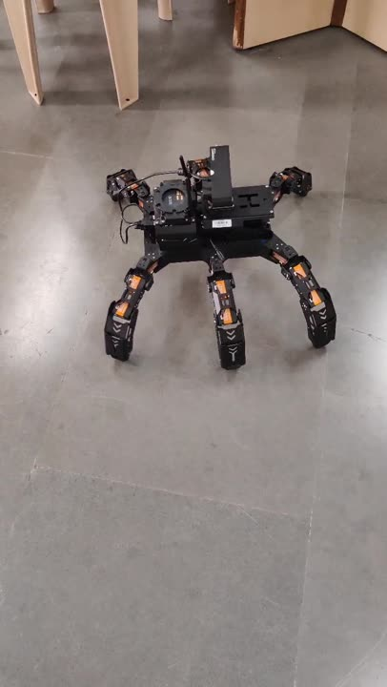
SLAM & NAVIGATION
Odometry, IMU, and LiDAR data are combined via EKF for more reliable localization.
The robot autonomously explores and maps the environment as it navigates.
Due to a faulty leg, the robot experiences difficulty in movement, which affects accurate mapping and leads to improper SLAM results.
The impaired leg movement further hampers destination goals, as poor localization prevents the robot from reaching the desired points.

Slide 13
WORKFLOW
JETHEXA HEXAPOD
SLAM IMPLEMENTATION
ROS NAVIGATION
RVIZ VISUALIZATION
ROSBRIDGE
WEBSOCKET
This framework allows you to effectively mimic the RViz functionality in a web browser while providing control capabilities for users who may not be familiar with the ROS ecosystem.
MAP DISPLAY NAVIGATION CONTROLS
WEB INTERFACE

Slide 14
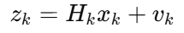
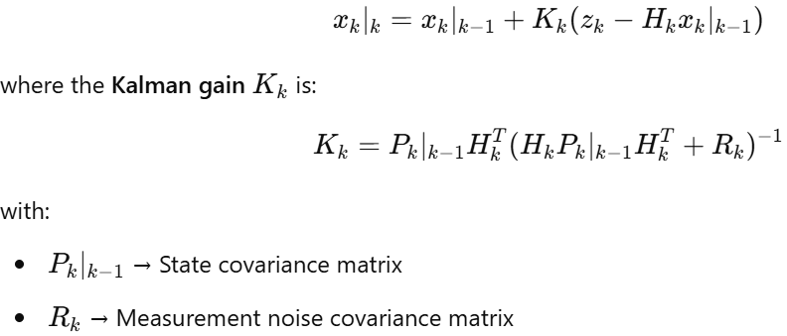
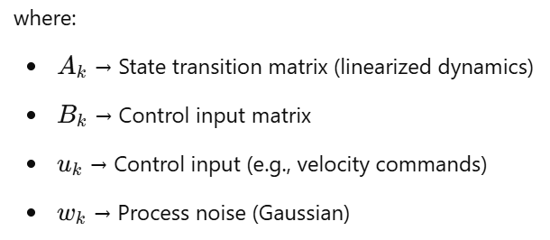
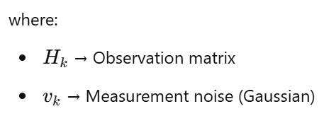
MATHEMATICAL PART
State Estimation for Localization (Kalman Filter/EKF)
The robot’s state x(k)=[x, y, θ]ᵀ is estimated using a Kalman Filter (KF).
Localization relies on predicting and correcting the state based on sensor data.
Update State
Observation State
Kalman Filter Update

Slide 15
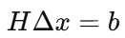
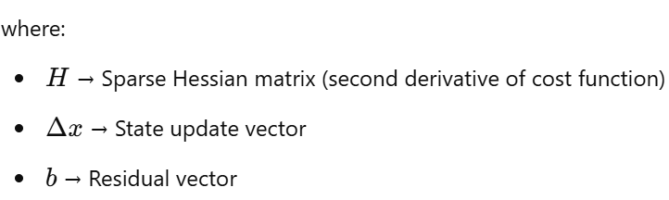
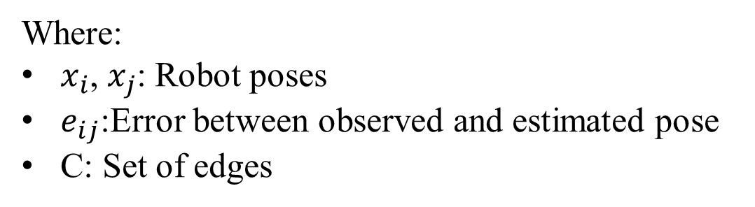
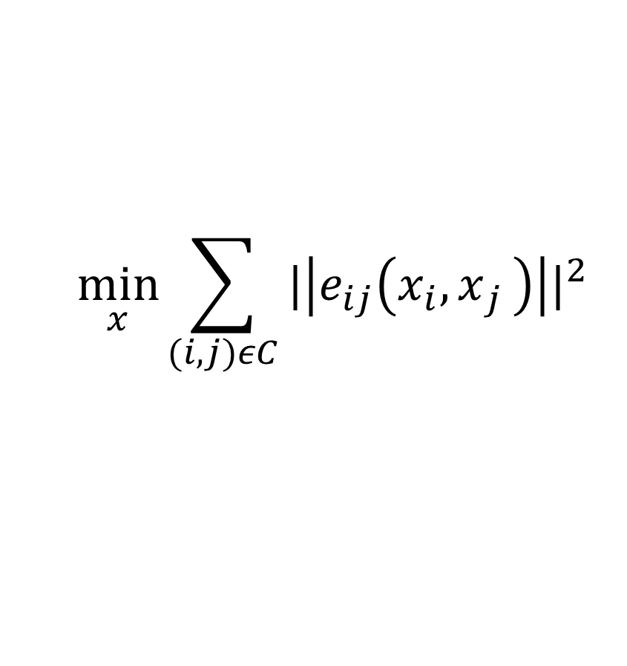
MATHEMATICAL PART
Sparse Linear Algebra for Pose Graph Optimization
RTAB-Map SLAM constructs a pose graph where:
Nodes → Robot position
Edges → Constraints between poses
Optimization Formulation
Sparse Linear System Solution
$$\min_{x}{\sum_{(i,j)εC}{{|\left|e_{ij}\left(x_{i}{, x}_{j}\right)\right||}^{2}}}$$
Where:
$x_{i}$, $x_{j}$: Robot poses
$e_{ij}$:Error between observed and estimated pose
C: Set of edges

Slide 16
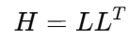
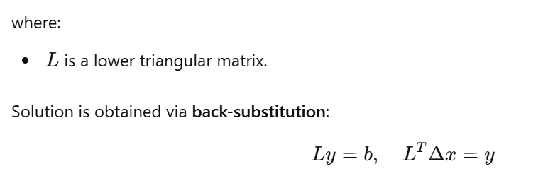
MATHEMATICAL PART
Sparse Linear Algebra for Pose Graph Optimization
RTAB-Map SLAM constructs a pose graph where:
Nodes → Robot position
Edges → Constraints between poses
Sparse matrices save memory & computation.
Improves map consistency and loop closure correction.
Solving Using Cholesky Decomposition

Slide 17
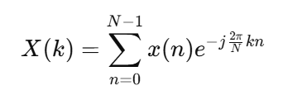
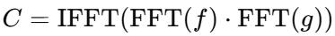
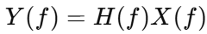
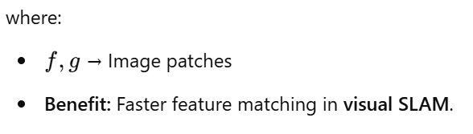
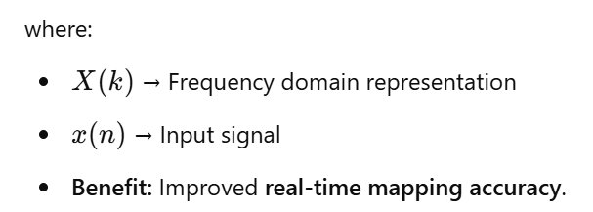
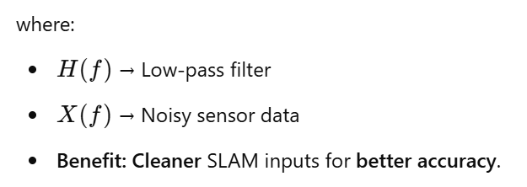
MATHEMATICAL PART
FFT/DFT in SLAM
Feature Matching in Visual SLAM
Use FFT for fast feature correlation in SLAM.
Compute cross-correlation in the frequency domain:
LiDAR and Sonar Signal Processing
DFT (Discrete Fourier Transform) enhances spatial feature extraction from LiDAR & sonar scans.
Frequency Domain Noise Filtering
FFT-based filtering removes high-frequency noise:

Slide 18

MATHEMATICAL FUNCTION
Our Robot needs accurate localization for mapping and navigation. By applying Extended Kalman Filter we combine odometry and IMU sensor data to estimate the robot’s current pose.
RTAB-Map internally builds a pose graph, each robot pose becomes a node, and movements between them create edges.
The optimization of this graph is based on sparse linear algebra techniques like solving large sparse matrices using Cholesky decomposition
Visual SLAM require precise feature matching between frames or signals. RTAB-Map internally uses frequency domain techniques like FFT to enhance these operations.
In LiDAR, FFT filters out high-frequency noise from distance signals, which improves obstacle detection
They work together in our robotic system to enable stable navigation. EKF keeps the robot localized, sparse optimization ensures that the map remains accurate over time, and FFT/DFT contribute to clean, reliable data input for SLAM

Slide 19
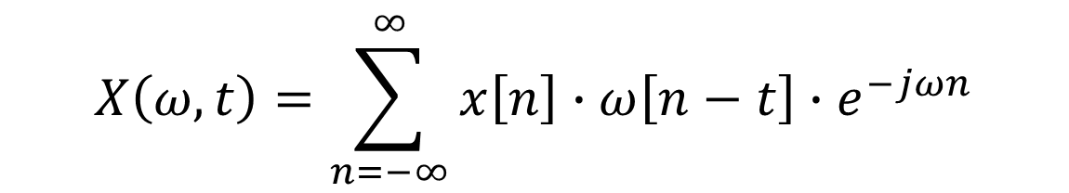
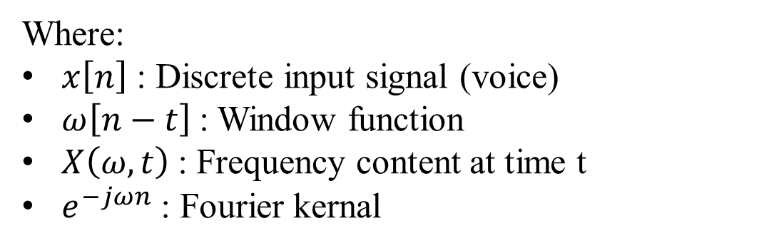
MATHEMATICAL PART
Short-Time Fourier Transform (STFT)
Speech signals change over time
STFT helps break down the audio into small segments to analyze what frequencies are present at each time step.
$$X\left(ω,t\right)=\sum_{n=−∞}^{∞}{x\left[n\right]}∙ω\left[n−t\right]∙e^{−jωn}$$
Where:
$x\left[n\right]$ : Discrete input signal (voice)
$ω\left[n−t\right]$: Window function
$X\left(ω,t\right)$: Frequency content at time t
$e^{−jωn}$ : Fourier kernal

Slide 20
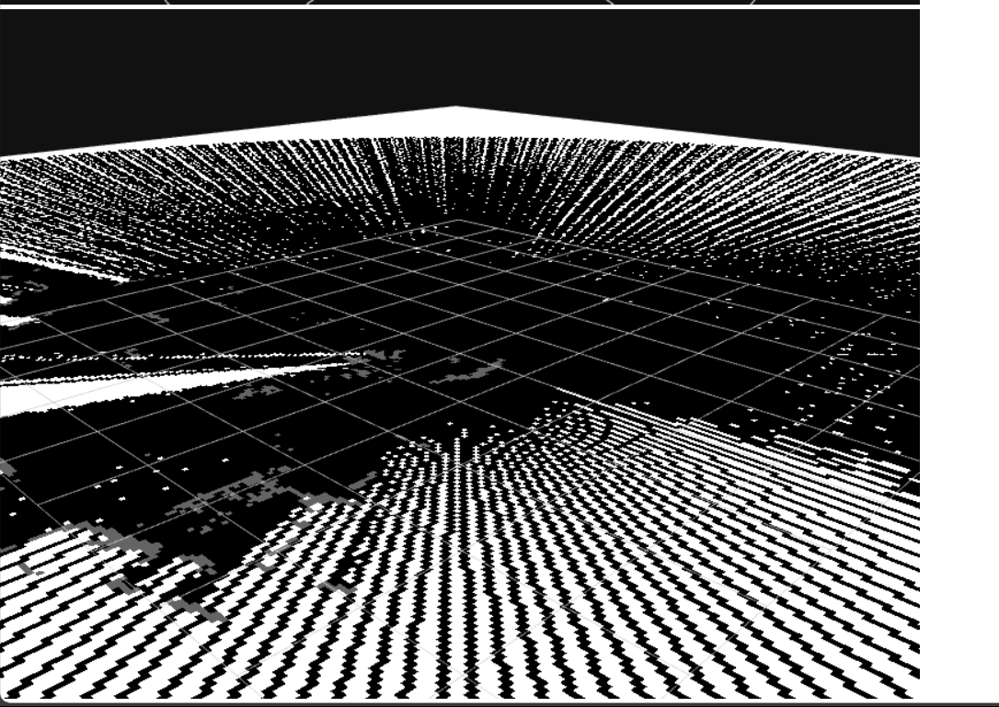
WEB INTERFACE
Built using Flask for backend handling and socket communication.
Connected to ROS via rosbridge for publishing goals and subscribing to robot states.
Current Implementation status
Real-time map rendering using roslib.
Goal selection and command publishing are still under work.
Planned integration with Supabase for storing logs and navigation history.
Challenges with Web Integration
Difficulty to handle real-time ROS message flow in browser.

Slide 21
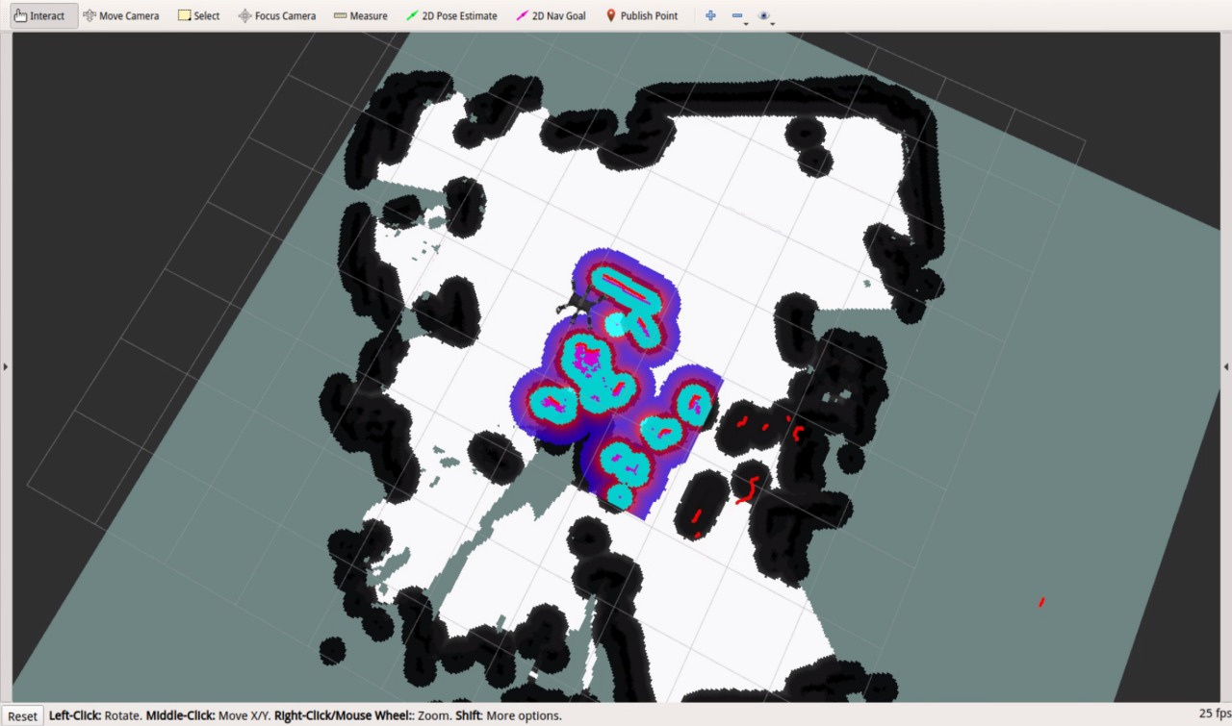
RESULTS AND OBSERVATION
2D map of lab generated using RTAB-Map with RPLiDAR. Map was visualized using RViz, showing wall outlines, obstacles and open spaces.
Although minor noise appeared in cluttered zones, map was sufficient for navigation.
During autonomous navigation the robot was able to move only 2-3 steps, cause after that the robot was unable to localize itself due to poor robot movement.

Slide 22
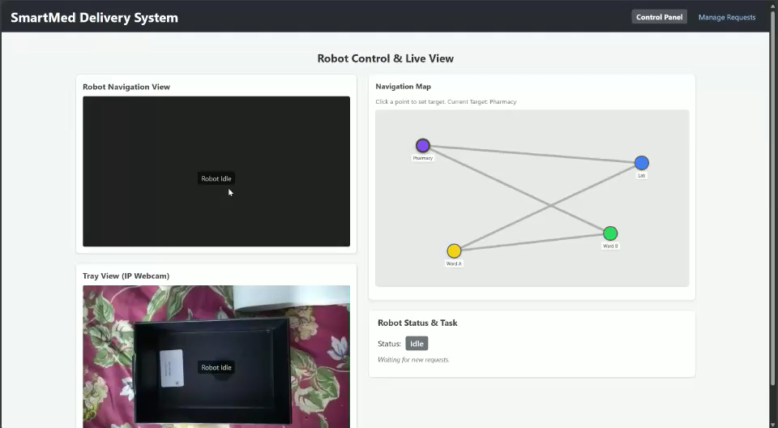
RESULTS AND OBSERVATION
Real-time control through the web interface was not fully integrated with ROS. Live feedback (position updates, map stream) not reliable outside local setup.

Slide 23
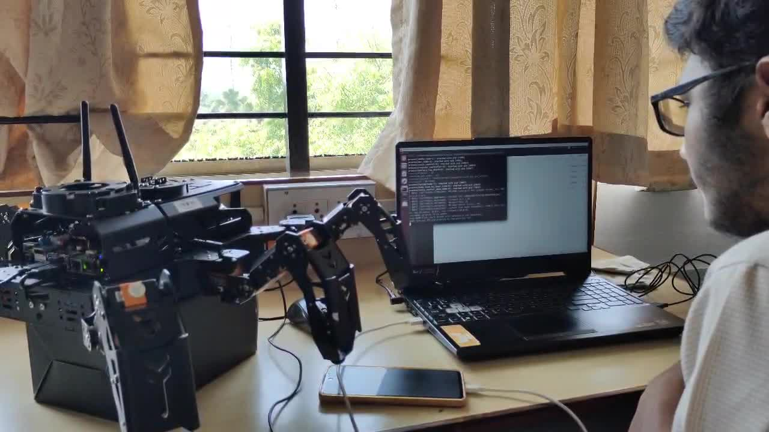
RESULTS AND OBSERVATION
As a optional work we achieved directional voice control using basic speech recognition.
Commands like forward, backward, left, right, stop.

Slide 24
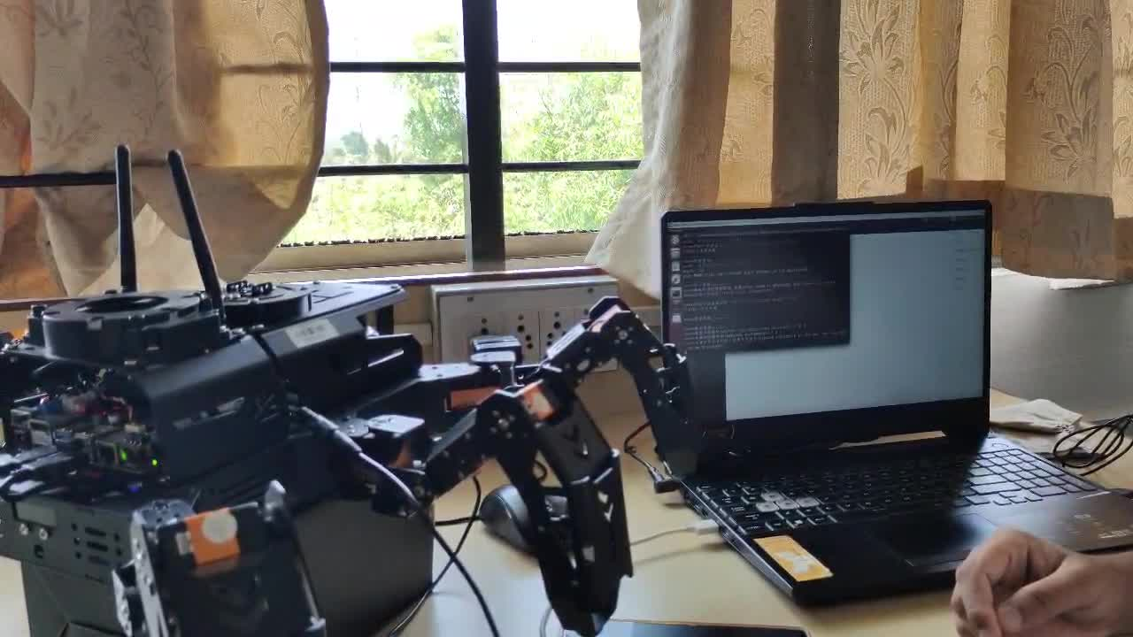
RESULTS AND OBSERVATION

Slide 25
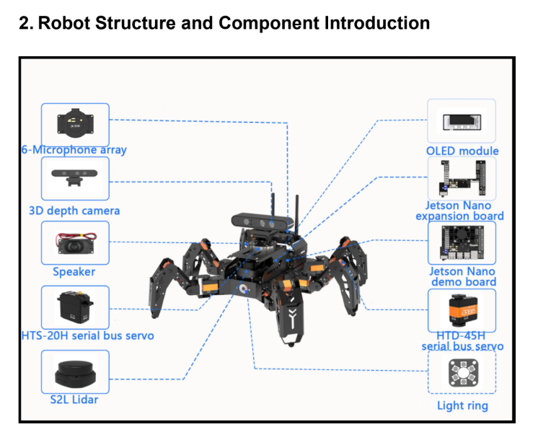
CONCLUSION & FUTURE WORK
Understood the integration challenges between robotics hardware and ROS software.
Gained hands-on experience with SLAM, LiDAR, and real-time robot localization.
Acquired foundational skills in web-based robot monitoring and control.
Future Implementation
Improve real-time synchronization between GUI and robot navigation status.
Integrate hospital backend systems (HIS/EHR) for intelligent task assignment.
Add database-driven task scheduling and patient-specific route planning.
Expand into patient monitoring and vitals integration using onboard sensors.

Slide 26
REFERENCES
[1] Ibrayev, S., Ibrayeva, A., Amanov, B. and Tolenov, S., 2024. Development of a Service Robot for Hospital Environments in Rehabilitation Medicine with LiDAR Based Simultaneous Localization and Mapping. arXiv preprint arXiv:2411.04797.
[2] Huang, H.W., Ehmke, C., Merewether, G., Dadabhoy, F., Feng, A., Thomas, A.J., Li, C., da Silva, M., Raibert, M.H., Boyer, E.W. and Traverso, G., 2023. Agile mobile robotic platform for contactless vital signs monitoring. Authorea Preprints..
[3] Rout, A., Reddy, H., Raj, S.V., Reddy, B., Naidu, L., Kiran, K. and Ravikumar, R., 2024, May. Development of LIDAR-SLAM Integrated Low Cost Health Care Monitoring Robot with Sustainable Material. In 2024 9th International Conference on Control and Robotics Engineering (ICCRE) (pp. 12-16). IEEE.
[4] Huang, H.W., Chen, J., Chai, P.R., Ehmke, C., Rupp, P., Dadabhoy, F.Z., Feng, A., Li, C., Thomas, A.J., da Silva, M. and Boyer, E.W., 2022. Mobile robotic platform for contactless vital sign monitoring. Cyborg and Bionic Systems.
[5] Huang, Y., Wang, Y., Li, X., Chen, H., Si, Y., Zhang, Y., Zhou, H., Yang, Y., Li, M., Xie, Y. and Wang, H., 2024, August. CMS-Robot: A Cloud Medical Service Robot Merging SLAM and IoT for Enhanced Healthcare Delivery. In 2024 IEEE 19th Conference on Industrial Electronics and Applications (ICIEA) (pp. 1-6). IEEE.
[6] Mireles, C., Sanchez, M., Cruz-Ortiz, D., Salgado, I. and Chairez, I., 2023. Home-care nursing controlled mobile robot with vital signal monitoring. Medical & Biological Engineering & Computing, 61(2), pp.399-420.

Slide 27
Thank you

